Slide 1
SS ZG 526: Distributed Computing
Distributed Mutual Exclusion (DME)
Chittaranjan Hota
Professor, Dept. of Computer Sc. & Information Systems
BITS, Pilani Hyderabad Campus, Hyderabad
hota@hyderabad.bits-pilani.ac.in

Slide 2

Maekawa’s DME Algo
Requesting the critical section
1. A site Si requests access to the CS by sending REQUEST(i) messages to all the sites in its request set Ri.
2. When a site Sj receives the REQUEST(i) message, it sends a
  REPLY(j) message to Si provided it hasn’t sent a REPLY message to a site from the time it received the last RELEASE message.
  Otherwise, it queues up the REQUEST for later consideration.
Executing the critical section
1. Site Si accesses the CS only after receiving REPLY messages from all the sites in Ri .
Birla Institute of Technology and Science, Pilani (Deemed University)

Slide 3

Continued…
Releasing the critical section
1. After the execution of the CS, site Si sends RELEASE(i) message to all the sites in Ri .
2. When a site Sj receives a RELEASE(i) message from site Si, it sends a REPLY message to the next site waiting in the queue and deletes that entry from the queue. If the queue is empty, then the site updates its state to reflect that the site has not sent out any REPLY message.
Birla Institute of Technology and Science, Pilani (Deemed University)

Slide 4
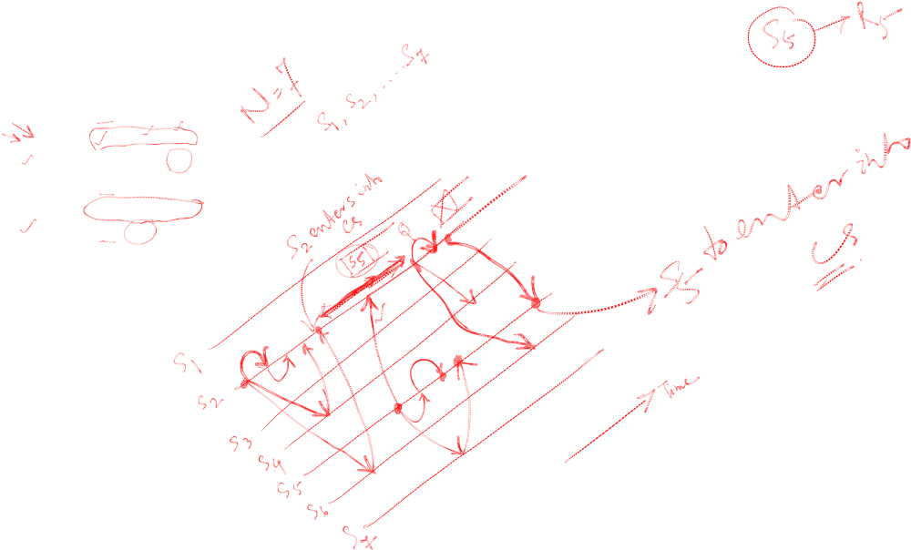
Example
R1 ← {S1, S2, S3}
R2 ← {S2, S4, S6}
R3 ← {S3, S5, S6}
R4 ← {S1, S4, S5}
R5 ← {S2, S5, S7}
R6 ← {S1, S6, S7}
R7 ← {S3, S4, S7}
Birla Institute of Technology and Science, Pilani (Deemed University)

Slide 5
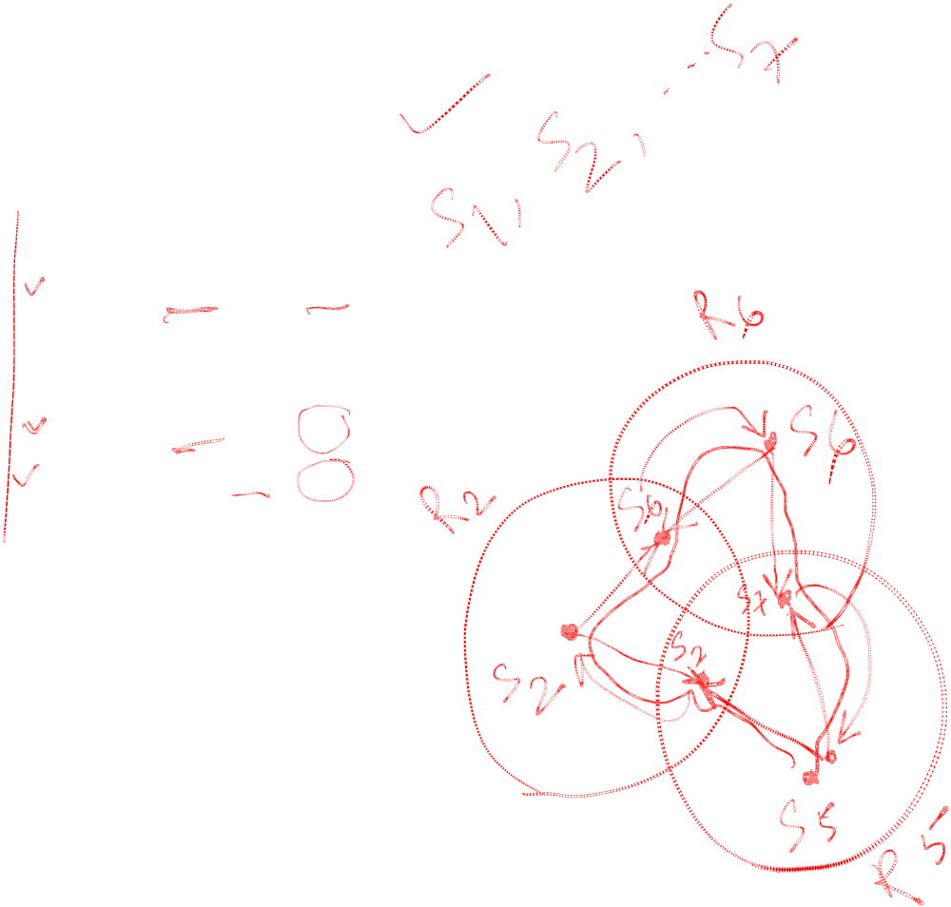
Deadlocks
R1 ← {S1, S2, S3}
R2 ← {S2, S4, S6}
R3 ← {S3, S5, S6}
R4 ← {S1, S4, S5}
R5 ← {S2, S5, S7}
R6 ← {S1, S6, S7}
R7 ← {S3, S4, S7}
Birla Institute of Technology and Science, Pilani (Deemed University)

Slide 6
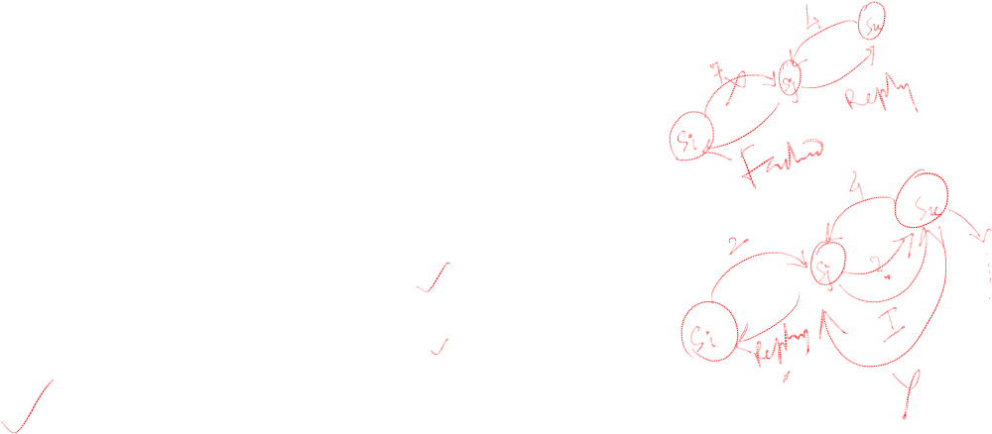
Deadlock handling
FAILED
A FAILED message from site Si to site Sj indicates that Si cannot grant Sj’s request because it has currently granted permission to a site with a higher priority request. So that Sj will not think that it is just waiting for the message to arrive.
INQUIRE
An INQUIRE message from Si to Sj indicates that Si would like to find out from Sj if it has succeeded in locking all the sites in its request set.
YIELD
A YIELD message from site Si to Sj indicates that Si is returning the permission to Sj (to yield to a higher priority request at Sj ).
Birla Institute of Technology and Science, Pilani (Deemed University)

Slide 7
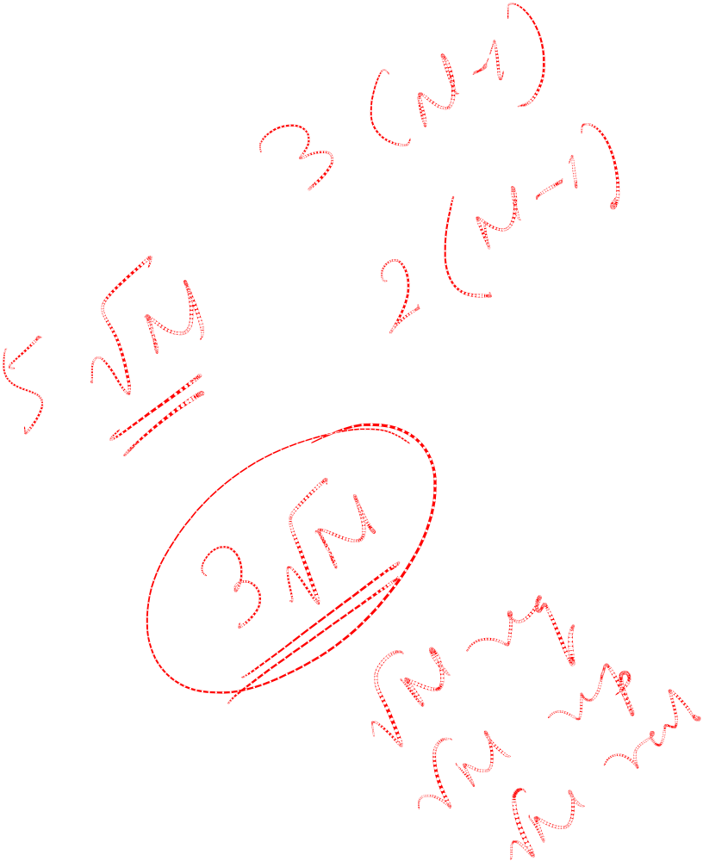
Next Session
Token based DME
Birla Institute of Technology and Science, Pilani (Deemed University)

